Slide 1
Dizziness

Slide 2
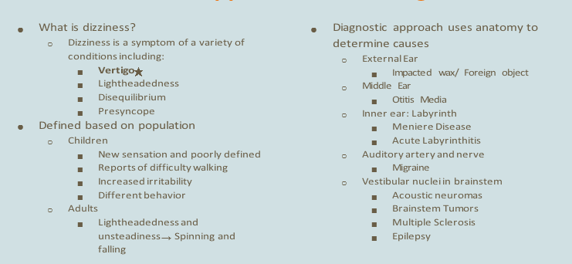
Dizziness: Approach to the Diagnosis

Slide 3
Dizziness vs. Vertigo

Slide 4
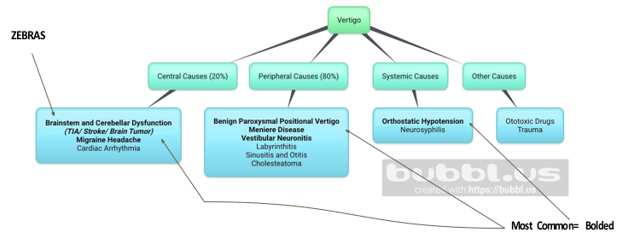
Differential Diagnoses R/T Vertigo

Slide 5
Differential Diagnoses Incidence/Prevalence

Slide 6
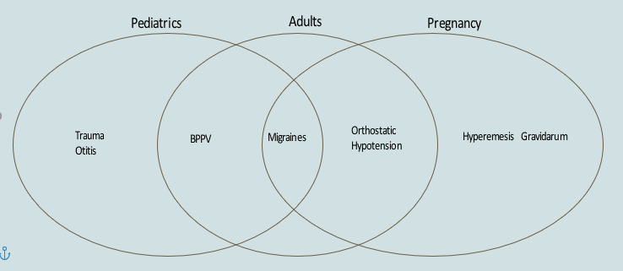
Most Common DDx in Peds, Adults, and Pregnancy

Slide 7
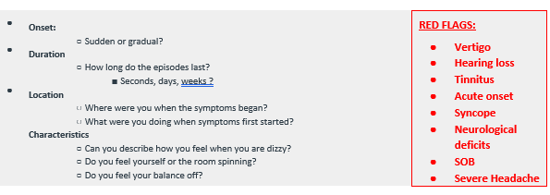
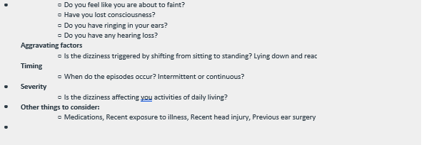
Subjective Information

Slide 8
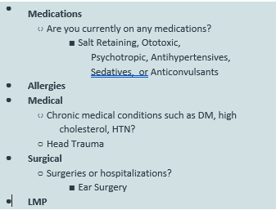
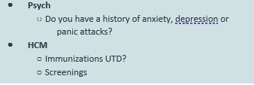
History of Present Illness

Slide 9
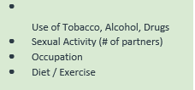
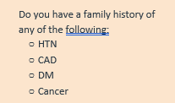
Social and Family History

Slide 10
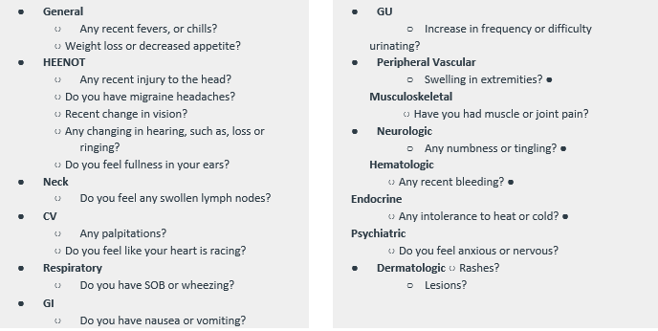
Review Of Systems

Slide 11
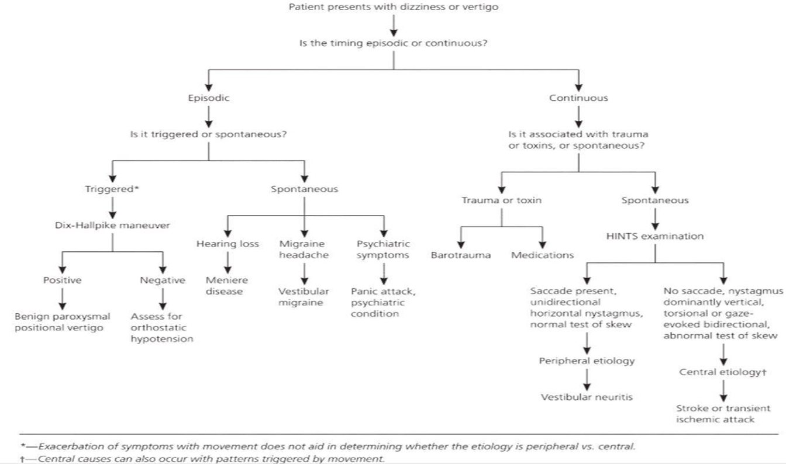
Dizziness flow sheet

Slide 12
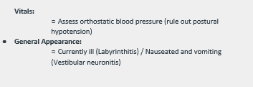
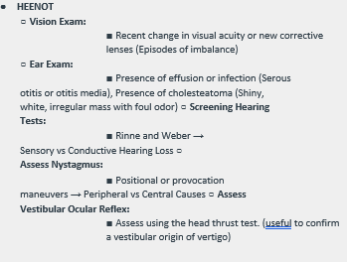
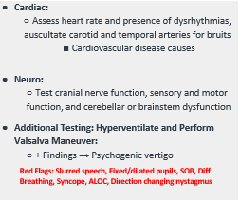
Objective Information

Slide 13
Assessment and Plan

Slide 14
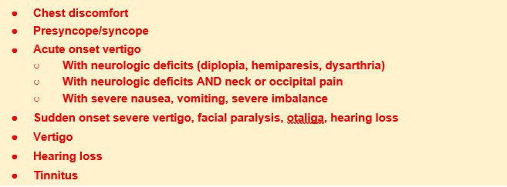
Overview of Red Flags

Slide 15
Case Study: Subjective

Slide 16
Case Study: Objective, Assessment and Plan

Slide 17
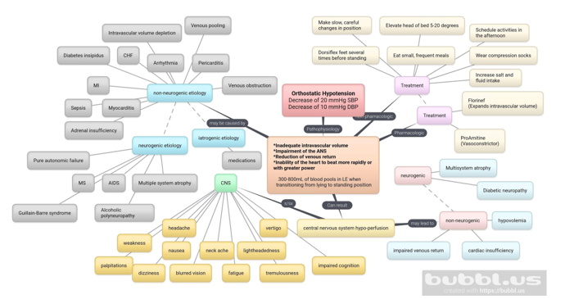
Case Study: Pathophysiology

Slide 18
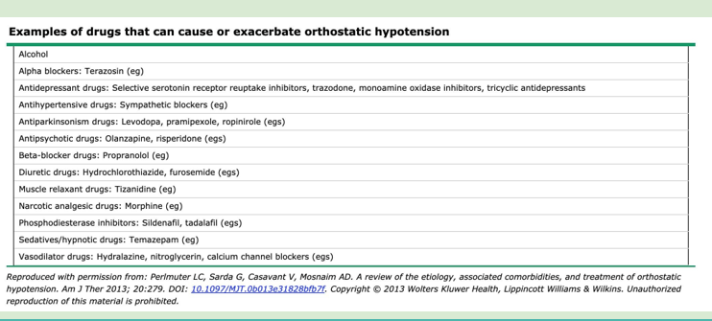

Slide 19
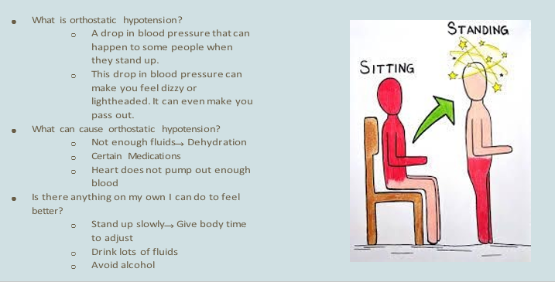
Orthostatic Hypotension in Layman’s Terms

